Slide 1
Prediction of water levels using machine learning with lag data
Sergio Villamarin

Slide 2
Overview
The Problem
State of the art
Data
Toy example
Approach
Approach (updates)

Slide 3
The problem: We flood
Water level extreme events on rivers or coastlines cause significant economic and structural losses every year. Having information of flood events ahead of time can significantly reduce the number of human casualties and provide time to take preventive actions and mitigate structural damage.

Slide 4
State of the art
Some of the ML approaches so far include:
Linear regression models
Support vector machines (with short/long-term memory)
Gaussian process regression model (supervised learning)
Neuronal networks (long and short term memory too)
And some common additional considerations
The use of lag data (up to 5 days)
Precipitation, dams, etc.

Slide 5
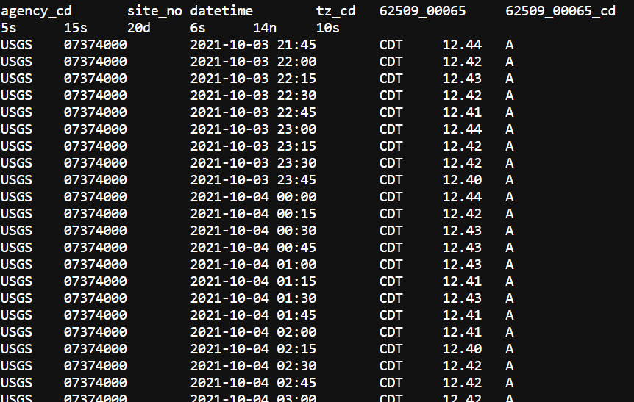
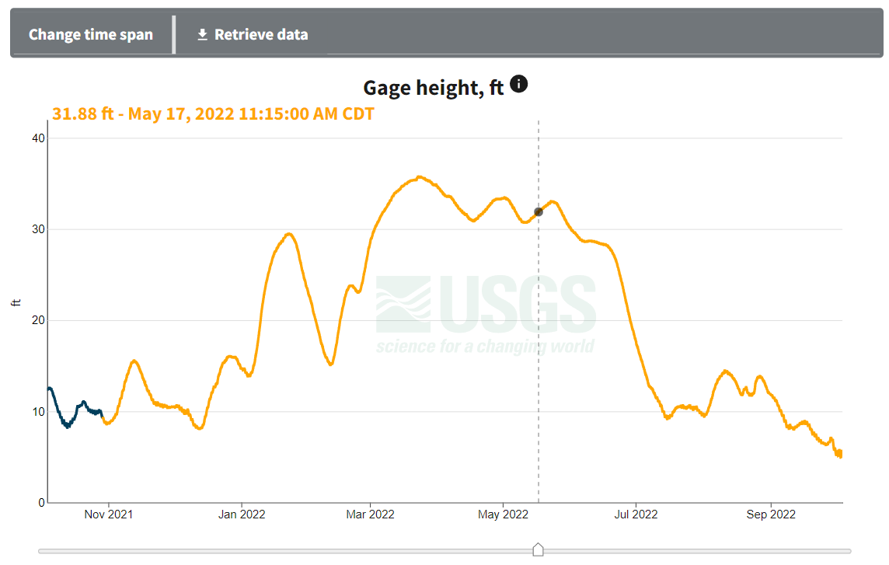
Data
USGS NATIONAL WATER DASHBOARD
​Federal domain containing information collected from stream gauges all over the country.
Data queries are implemented on R.
Time series of some stations is limited and the baselevel of some gauges has changed.

Slide 6
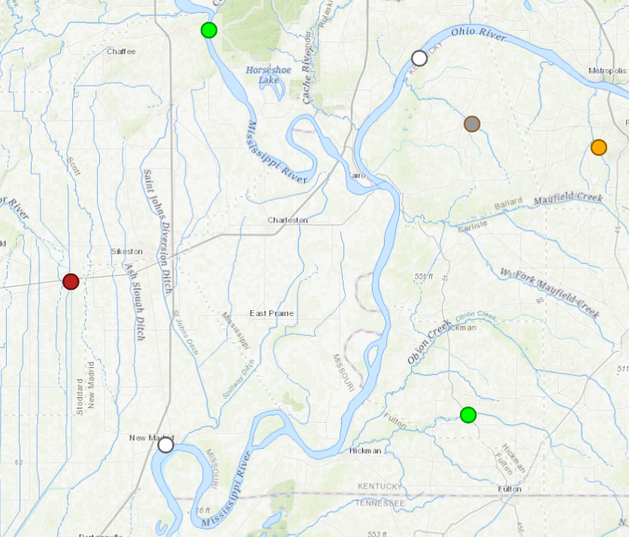
Toy example
The Ohio River is one of the main tributaries to the Mississippi river. Data for testing has:
Daily averages Q
Instantaneous WLs
Missing values.
Ranges of dates that don’t match.
Same Timezones (for now at least)
Data from several years

Slide 7
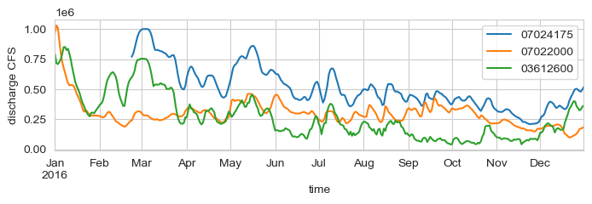
This is how discharge data looks

Slide 8
Approach
Determining appropriate lags
Application of Linear and SVM models
Testing and evaluation
Choosing meaningful hydraulic parameters for input in the model
Use of partial autocorrelation and regular correlation for the estimation of lags for the different hydraulic parameters
Use different combinations of lags and hydraulic parameters
A first exploration using a linear model and then a support vector machine.
Designing a baseline model using only local parameters on the input
Define appropriate regularization terms to mitigate overfitting from aggregation of parameters
Define metrics to evaluate effectiveness of the model compared to the baseline

Slide 9
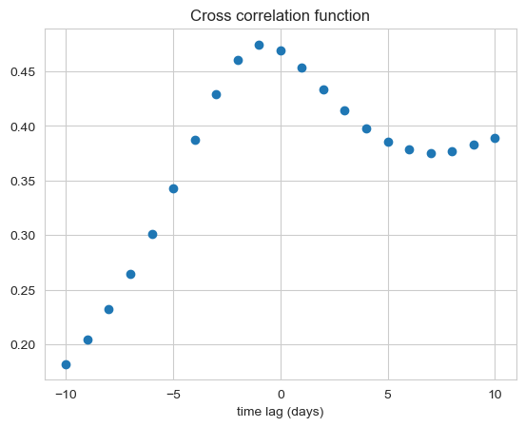
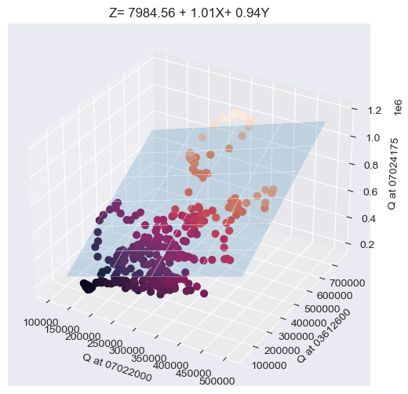

Approach (so far)
Determining appropriate lags
Application of Linear and SVM models
Testing and evaluation
I managed to do cross correlations function that deals with the data issues (I think)
I used the timelagged data to create a basic linear (regression) model
This is the next step after I check I can apply the SVM model using more lags

Slide 10
Change of scope
Due to time constraints, collecting data from USGS by hand for each station is not feasible
Which tributaries should be included
Availability of data in the same time ranges
Timezones
Context for the analysis
Hydraulic parameter data format

Slide 11
Approach
Determining…
Fix a context and find the lags
Application of Linear and SVM models
Testing and evaluation
Choosing meaningful hydraulic parameters…
Use of partial autocorrelation and cross correlation for the estimation of lags for the different hydraulic parameters
Use data from the mainstream Mississippi
Use different combinations of obtained lags and hydraulic parameters
A first exploration using a linear models.
Application of a support vector machine. (tunning parameters)
Designing a baseline model using only local parameters on the input
Define appropriate regularization terms to mitigate overfitting from aggregation of parameters
Define metrics to evaluate effectiveness of the model compared to the baseline

Slide 12
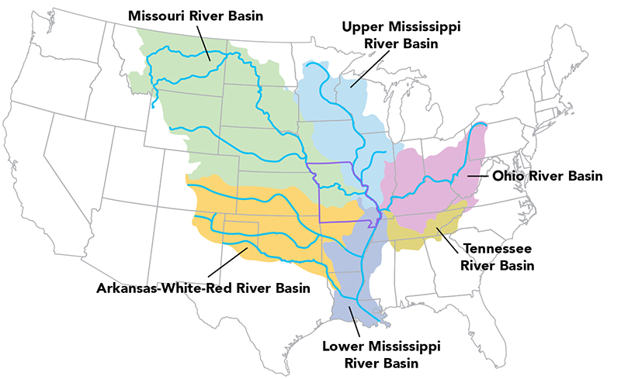
The Mississippi River basin
(Mayor tributaries and sub-basins are shown)

Slide 13
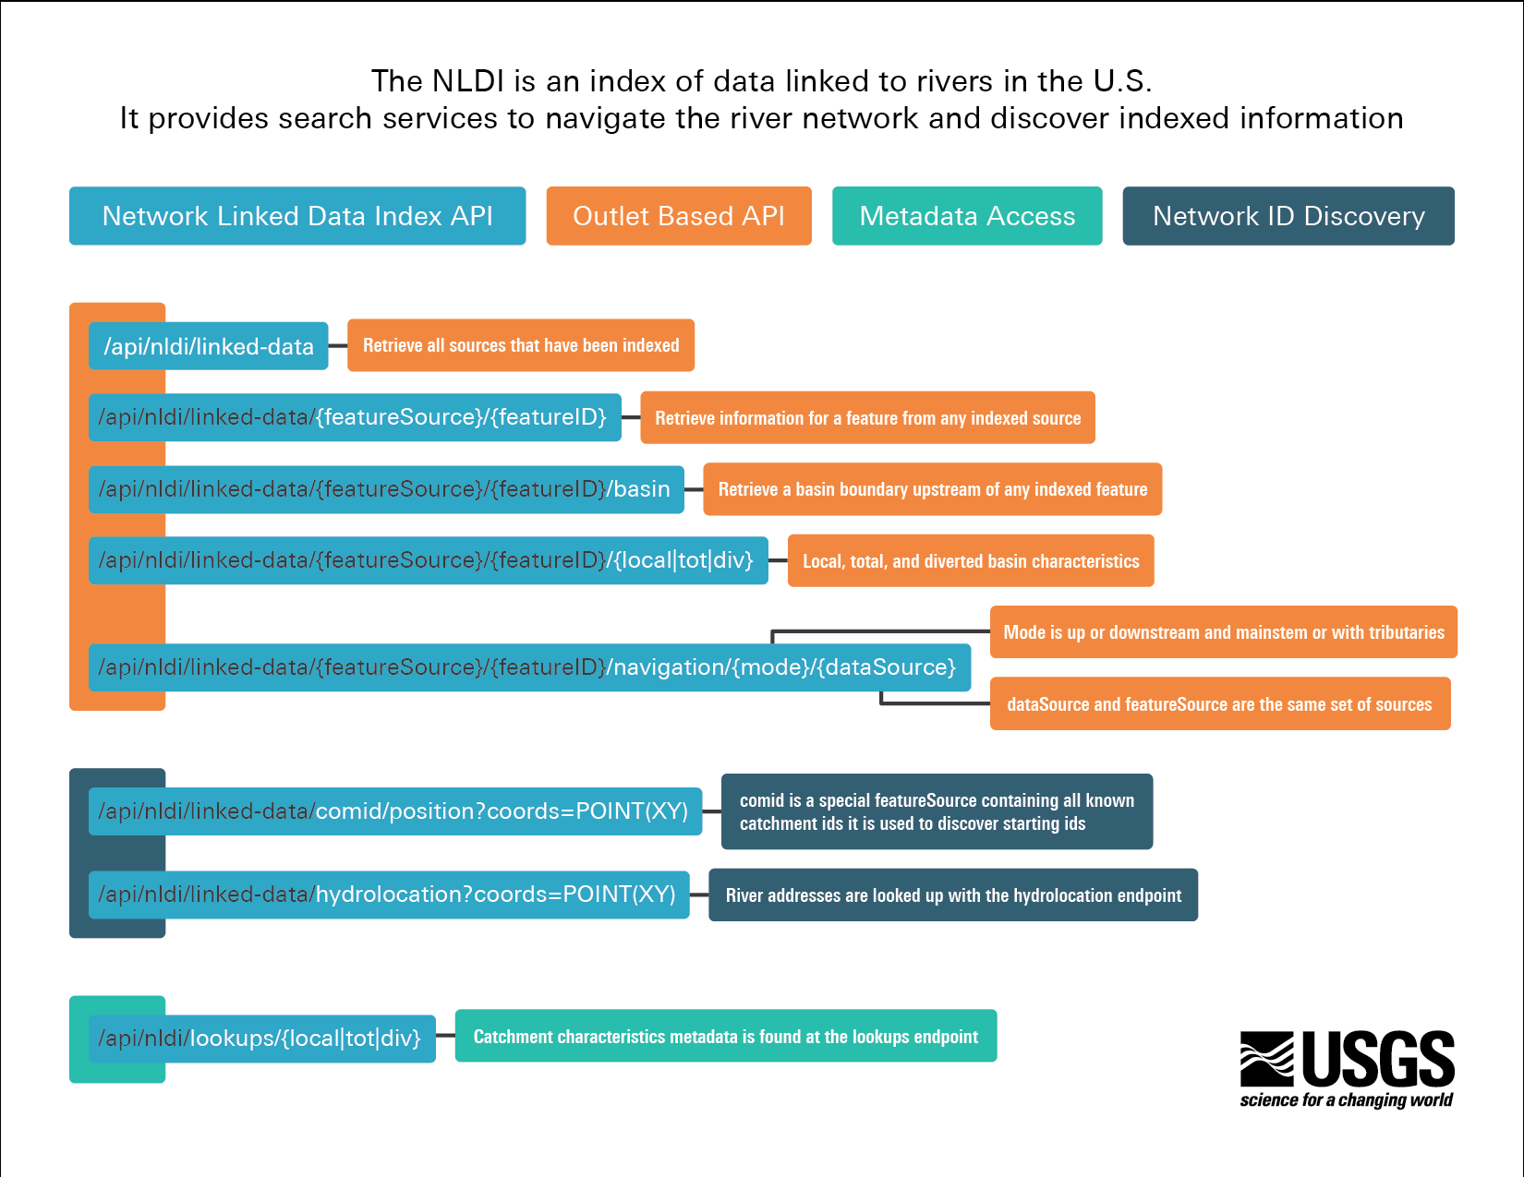
NLDI
Navigation upstream can be done using the Hydro-Network Linked Data Index.I used their API to make url queries for the mainstream Mississippi River

Slide 14
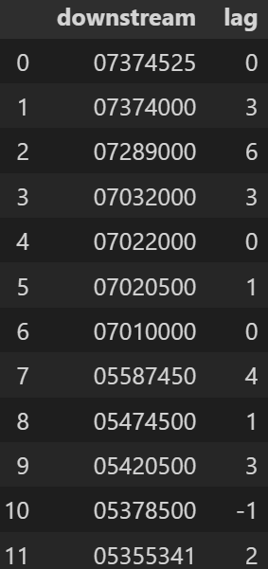
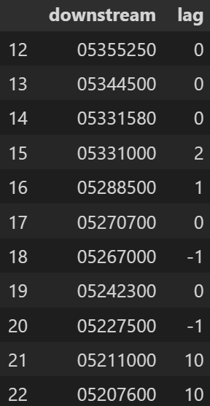
Cross correlation lags

Slide 15
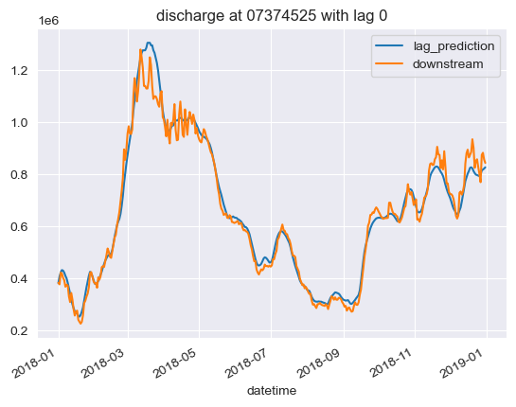
Regression results

Slide 16
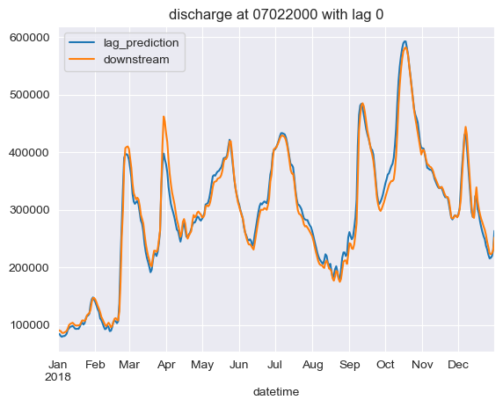
Regression results

Slide 17
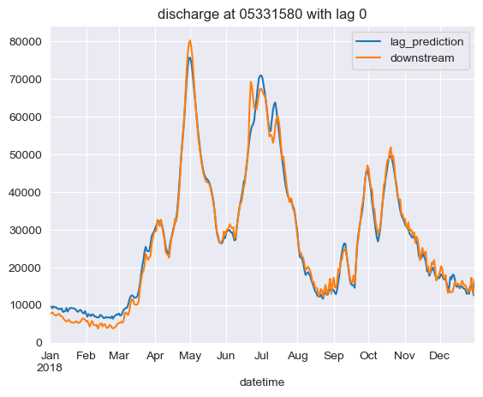
Regression results

Slide 18
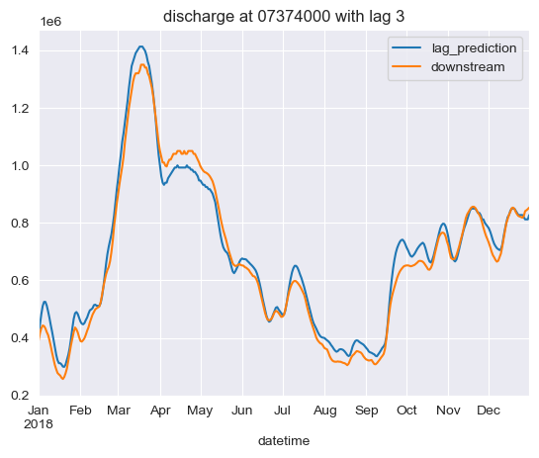
Regression results

Slide 19
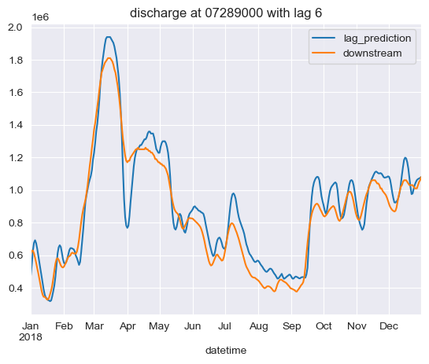
Regression results

Slide 20
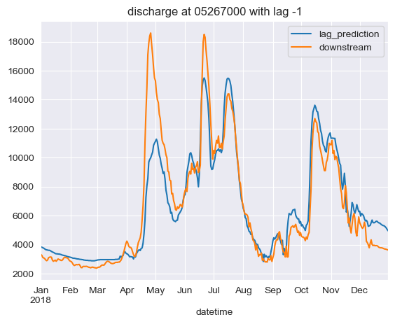
Regression results

Slide 21
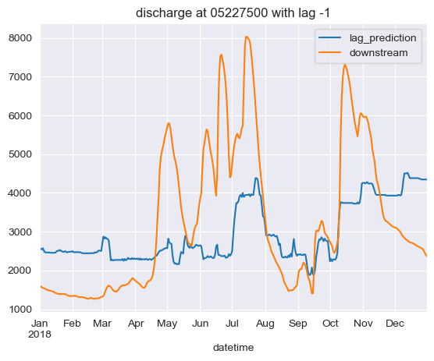
Regression results (issues)

Slide 22
Regression results (issues)

Slide 23
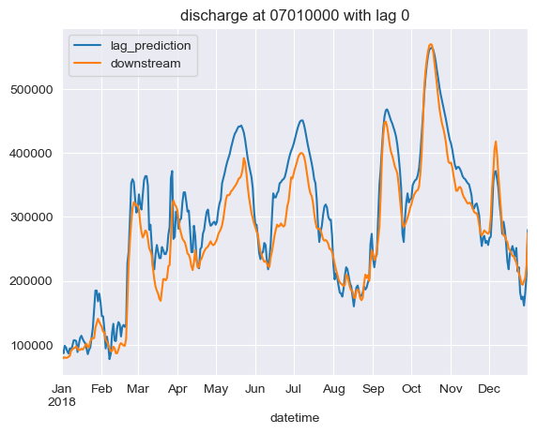
Regression results (issues)

Slide 24
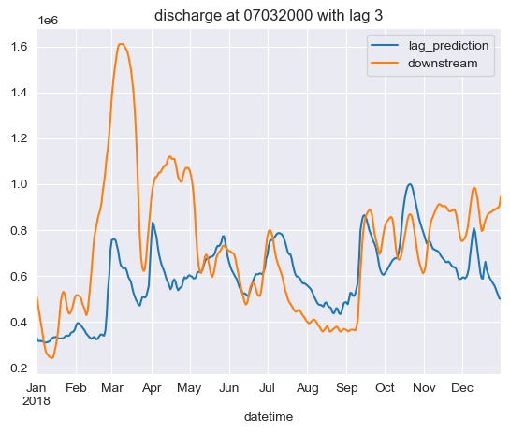
Regression results (issues)

Slide 25
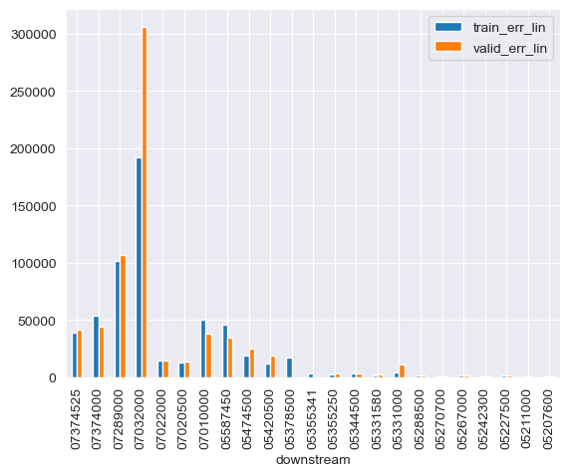
RMSE

Slide 26
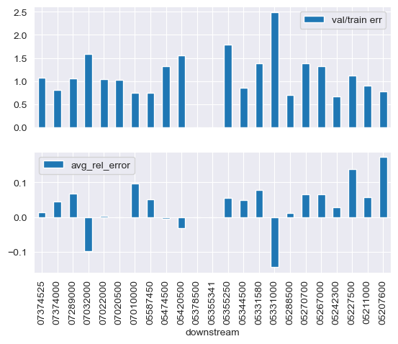
Relative errors

Slide 27
Thanks
Questions?

